Slide 1
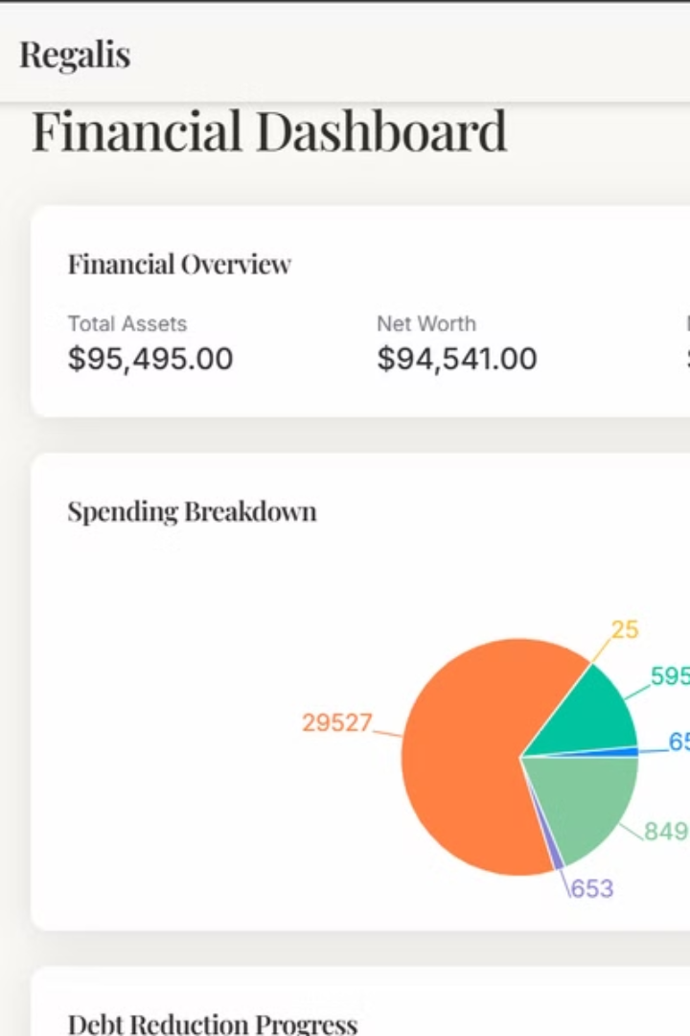
Regalis - Your Personal Finance Solution
Take command of your financial destiny with Regalis, the all-in-one personal finance solution. Effortlessly track your expenses, expertly manage your budgets, and unlock a wealth of insightful data to guide your path to financial freedom.
Regalis puts you in the driver's seat, empowering you to navigate your financial landscape with confidence. Seamlessly log your transactions, categorize your spending, and monitor your progress towards your savings goals. Regalis' intuitive interface makes managing your money a seamless experience, freeing you to focus on what truly matters.

Slide 2
Dashboard Overview
Account Balances
Recent Transactions
Spending Patterns
Regalis brings all your financial accounts together in one unified dashboard, providing you with a comprehensive view of your money at a glance. No more juggling between multiple apps and logins - Regalis seamlessly connects to your bank accounts, credit cards, and investment portfolios, giving you a centralized hub to manage your entire financial life.
At a glance, Regalis puts your latest spending activity front and center. No more digging through endless transaction lists - our intuitive dashboard surfaces your most recent purchases, categorized and organized for easy reference. With Regalis, you can quickly review where your money is going, identify any unusual charges, and gain valuable insights to inform your budgeting decisions.
Regalis provides you with a clear, comprehensive view of your spending habits, empowering you to gain a deeper understanding of where your money is going each month. By centralizing all of your financial data in one intuitive dashboard, our platform shines a spotlight on your latest transactions, categorized and organized for easy reference.

Slide 3
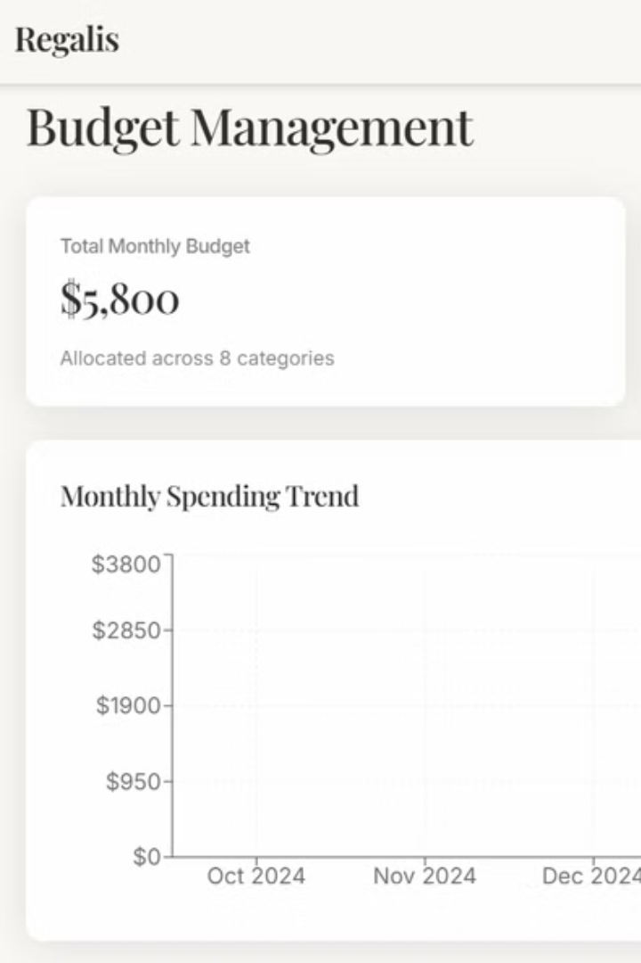



Transaction Management
Easy Addition
Detailed View
Add income and expenses effortlessly. To keep track of your icome and expenses
View all transactions in one table. Gives a overall view of the transactions
Categorization
Categorize your income and expenses. It cleverly categorizes the money spend.

Slide 4



Budgeting Tools
Track Spending
2
Against budget targets
Create Budgets
1
Personalized to your needs
Visualize Progress
3
See how you are doing

Slide 5
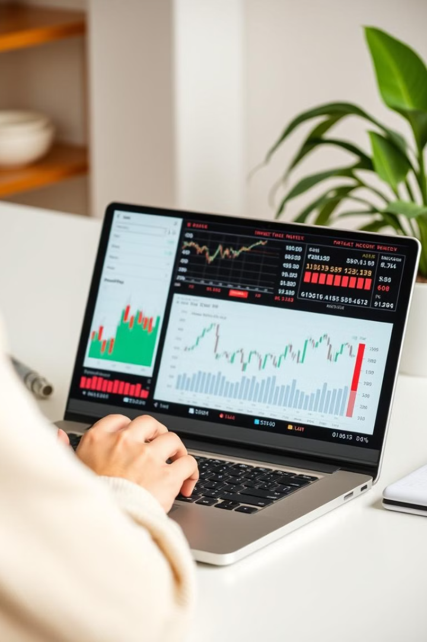
Investment Tracking
Portfolio Monitoring
Track your investments.
Performance Charts
View investment returns.
Growth Projections
Explore opportunities.

Slide 6

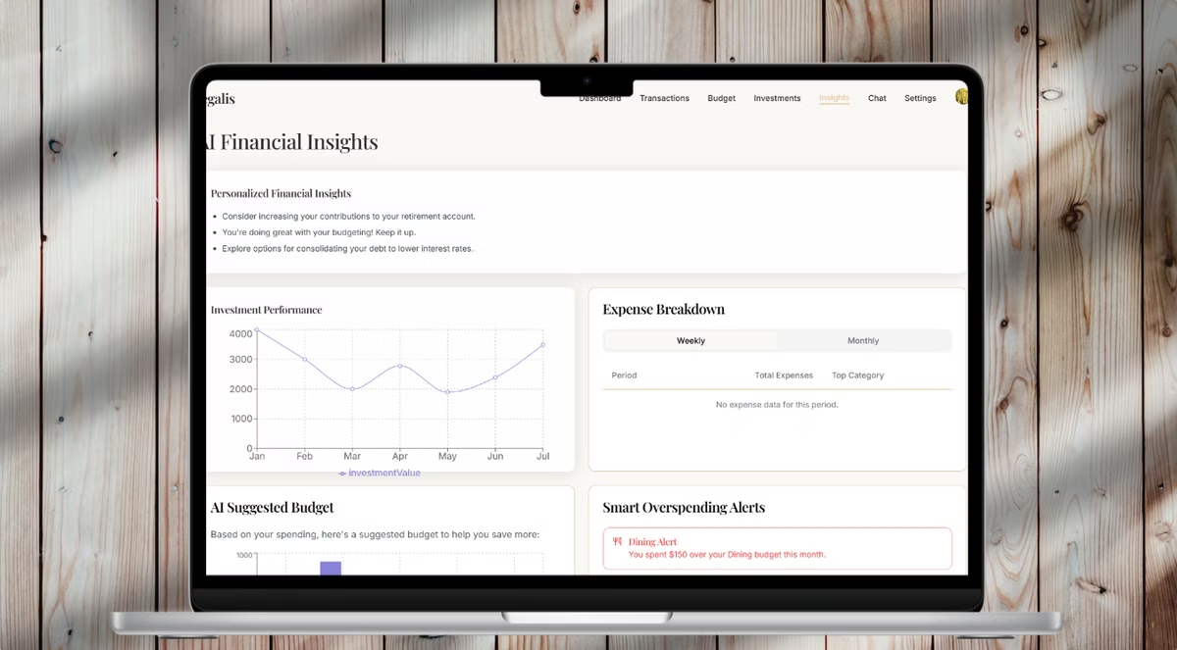




AI-Powered Insights
Savings
Recommendations
Debt Reduction
Strategies
Investment
Opportunities
Credit Score
Improvement

Slide 7

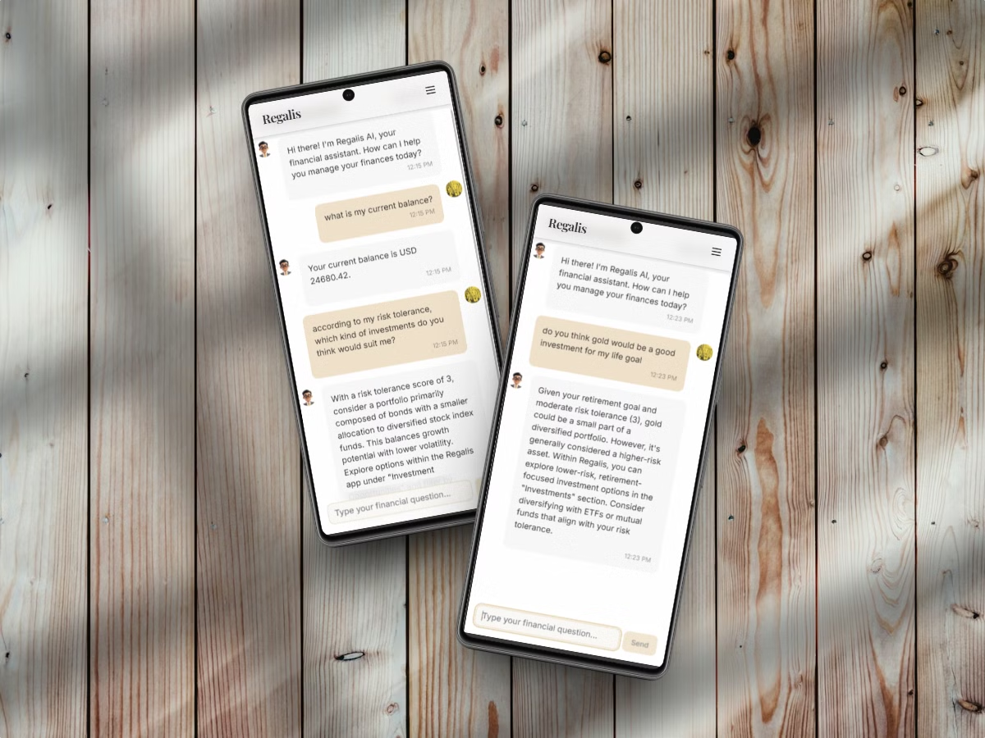



Interactive Chat
Instant Answers
AI Assistant
Financial Questions

Slide 8



Secure Authentication
1
User Management
2
Secure Login
3
Financial Data Safety

Slide 9

Key Takeaways
Manage Finances
AI Insights
Track expenses, budgets, investments.
Get personalized recommendations.
Secure and Customizable
Tailor the app to your needs.

Slide 10
Team Title - Cando boys
Team Members
Pranav.TJ
Jheyanth.CS
ALLWIN JOSHUA.RS
22BEE1134 - EEE
22BEE1055 - EEE
22BEE1032 - EEE

